Slide 1

NGULAR
Özgür Kaplan
ozgur.Kaplan@kocsistem.com.tr

Slide 2
Course Outlıne

Slide 3
Angular Is…
A JavaScript framework
For building client-side applications
Using HTML, CSS and JavaScript

Slide 4
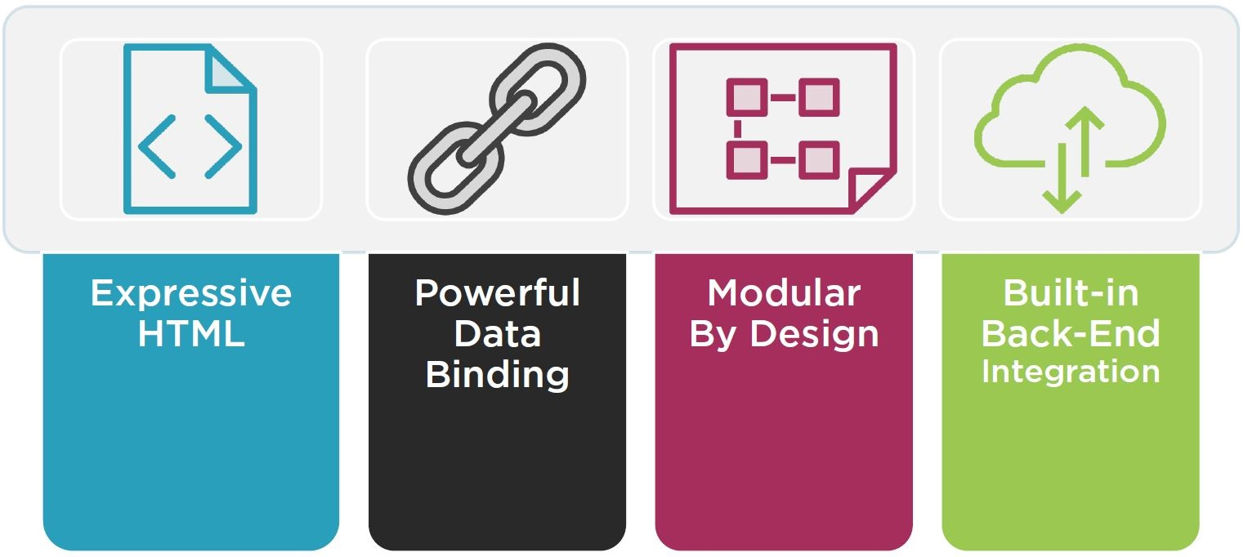
Why Angular?
Notes:
Expressive HTML -> If condition, for loop, loal variable
Powerful Data Binding -> Display field from data model, track changes, process update from user
Modular By Design -> Set of building blocks, create and reuse content
Build-in Back-End Integration -> Get, Post Data, Execute server side business data

Slide 5
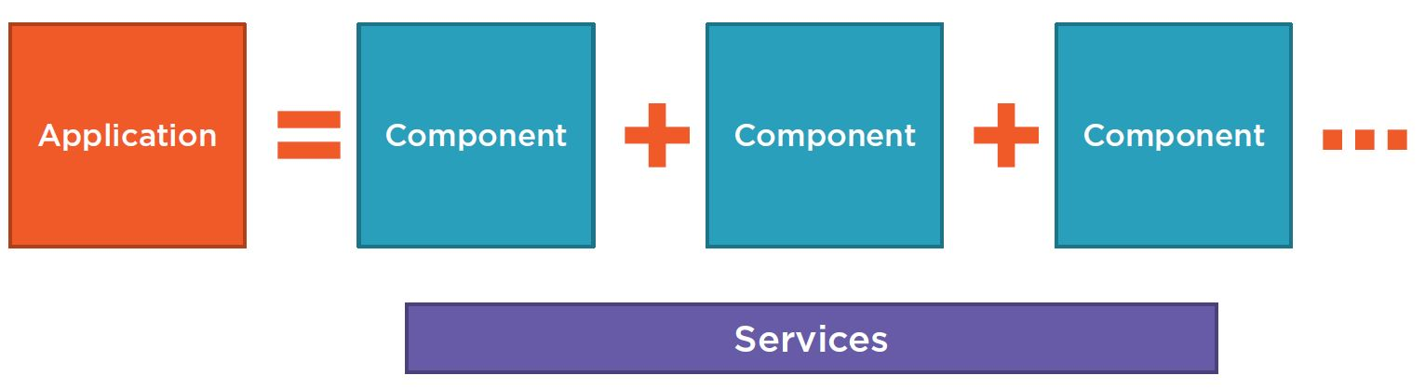
Anatomy of an Angular Application
Notes:
Application = set of companents
Services provides functionality across components

Slide 6
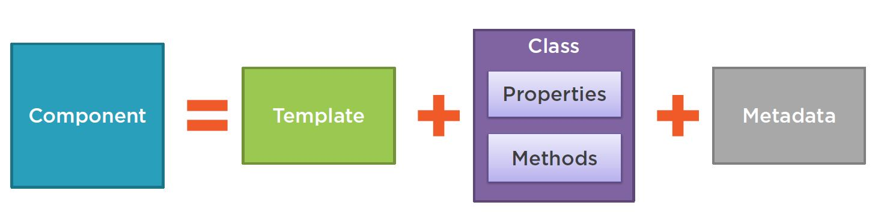
Component
Notes:
Template = HTML
Properties = Data elements to use in view
Methods = events
Metadata = Additional information and Identifies class as an angular components

Slide 7
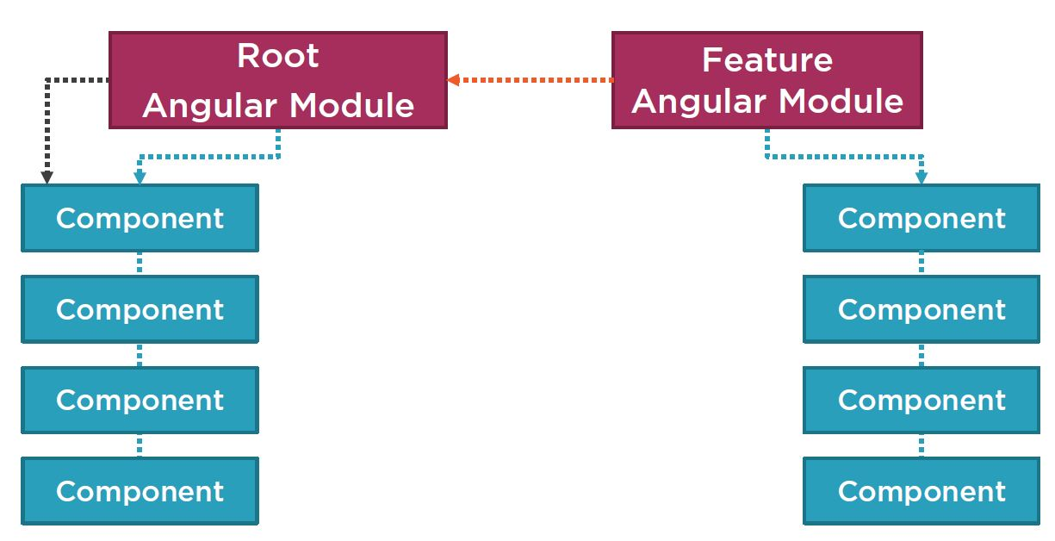
Angular Modules

